Slide 1
Simple task manager

Slide 2
PHP 8.1
Symfony 6

Slide 3
Project structure
This project is structured following Domain Driven Design principles. As the application is very small, there is only one bounded context (Manager) and a Domain (Task). This domain is divided in the three common DDD layers:
Application
Domain
Infrastructure

Slide 4
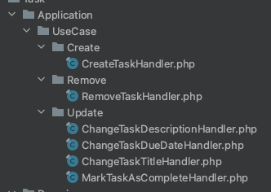
Project structure
Application: This layer contains the use cases of creating, updating and removing tasks.

Slide 5
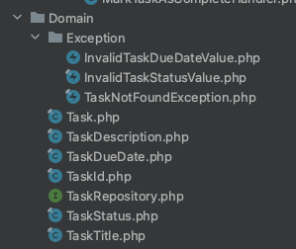
Project structure
Domain: Here live the definition of the aggregate Root, the value objects, the repository interface and the exceptions.

Slide 6
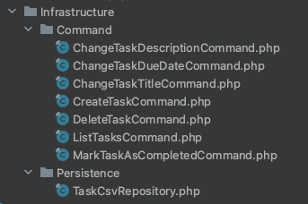
Project structure
Infrastructure: Here live the persistence implementation and the different Symfony commands.

Slide 7
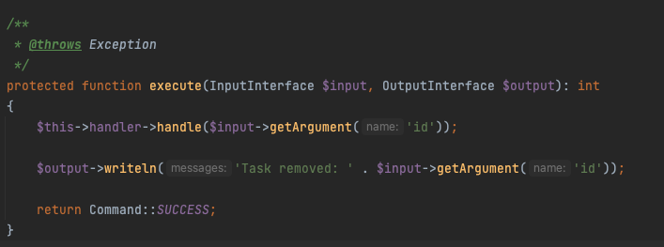
Commands
Reads the user input and calls the use case’s handler

Slide 8
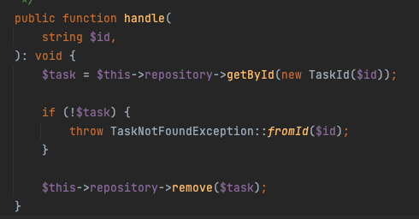
Use cases
Handles the logic, uses repository methods

Slide 9

Persistence
Tasks are persisted in a CSV file located in the root of the project.

Slide 10
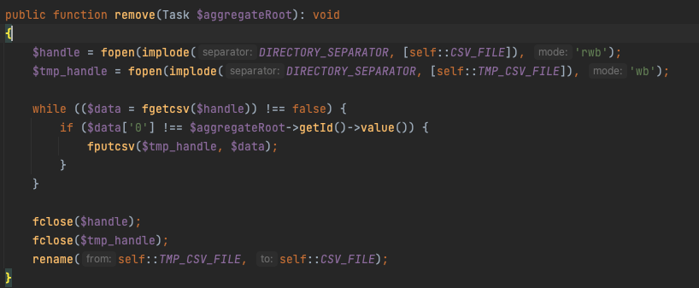
Persistence
As a result of being stored in a CSV, repository methods are a bit inefficient. For instance, the remove function creates a whole new file with all the records but the one being deleted. This is not ideal, but it's no issue with a project this size and it's all the Standard library allows.

Slide 11
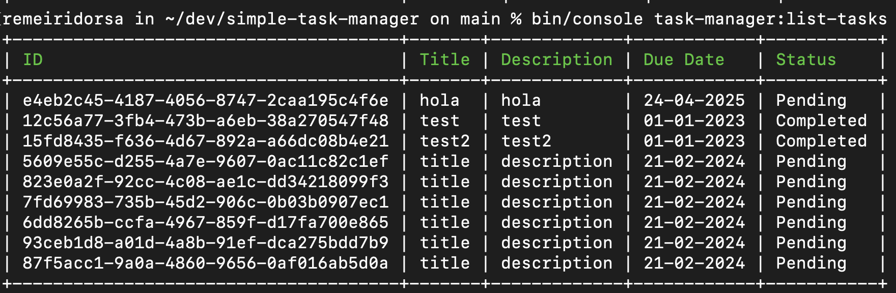
Examples: listing
List all tasks

Slide 12
Examples: creating and deleting

Slide 13
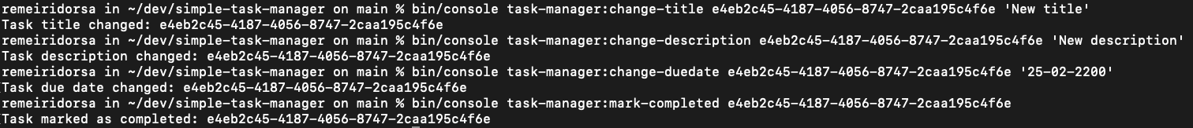
Examples: updates

